Slide 1



Agile Methodologies in Education
The Common Ground of Personalized Learning and Project-Based Learning
Carlos Cunha
SERA 2025, Las Vegas

Slide 2
Polytechnic University of Viseu
5 Schools

Slide 3





project based learning (PBL)
active learning
real projects
team work
product-oriented
reflective

Slide 4

agile methodologies / SCRUM
weeks
INCREMENT

Slide 5




SCRUM in the classroom
engagement

Slide 6



research design: group characterization
Bachelor in
Computer Engineering (BCE)
Bachelor in
Web Computing (BWC)
Master in
Electrical Engineering (MEE)
84%
16%
79 participants
2-5

Slide 7





research design: tasks
5 sprints
personas
scenarios
user stories
system architecture
use case, class, activity, sequence, and state diagrams
wireframes and mockups
coding (Java, C#, or Python)

Slide 8
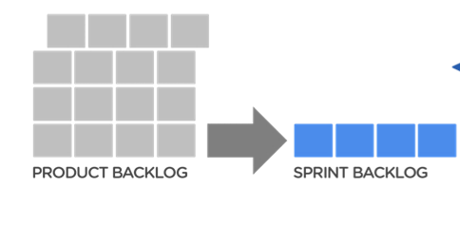

research design: methodology
sprint review
sprint planning
sprint
retrospective

Slide 9
research questions
RQ1: Can students communicate effectively using an
Agile methodology?
RQ2: Do students understand and apply the Agile
methodology principles?
RQ3: Are technologies giving appropriate support to the
software development methodology?
RQ4: Are the software engineering principles and artifacts
well understood?

Slide 10
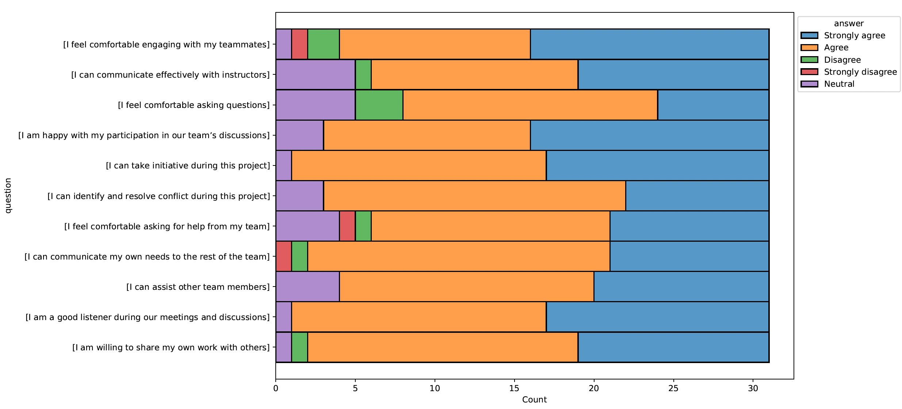
RQ1. Can students communicate effectively using an Agile methodology?
some students are uncomfortable with group communication
Notes:
reflexive students are usually introspective,
analyze information without external stimuli,
and prefer not to interact proactively with their partners.
On the contrary, active students tend to participate actively in discussions.

Slide 11
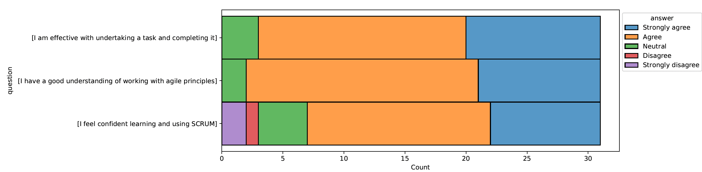
RQ2. Do students understand and apply the Agile methodology principles?
some students demonstrated difficulties applying the Scrum methodology

Slide 12
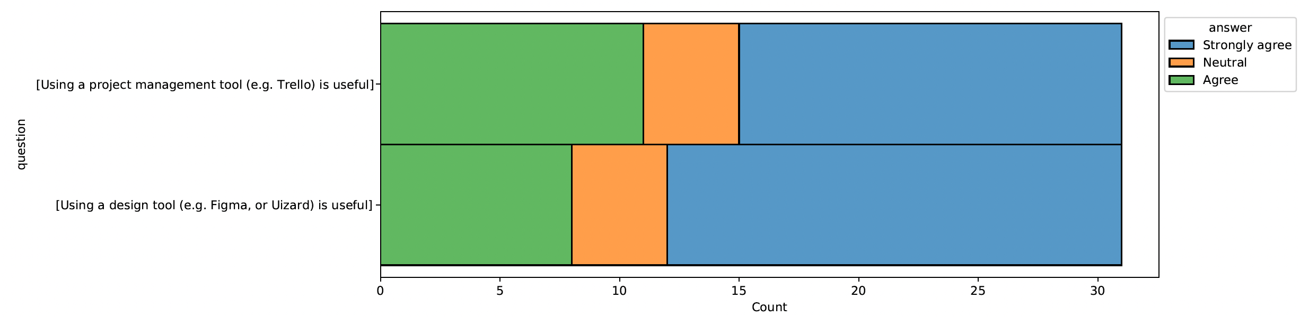
RQ3. Are technologies giving appropriate support to the SW development methodology?
none of the students reported limitations with using these tools

Slide 13
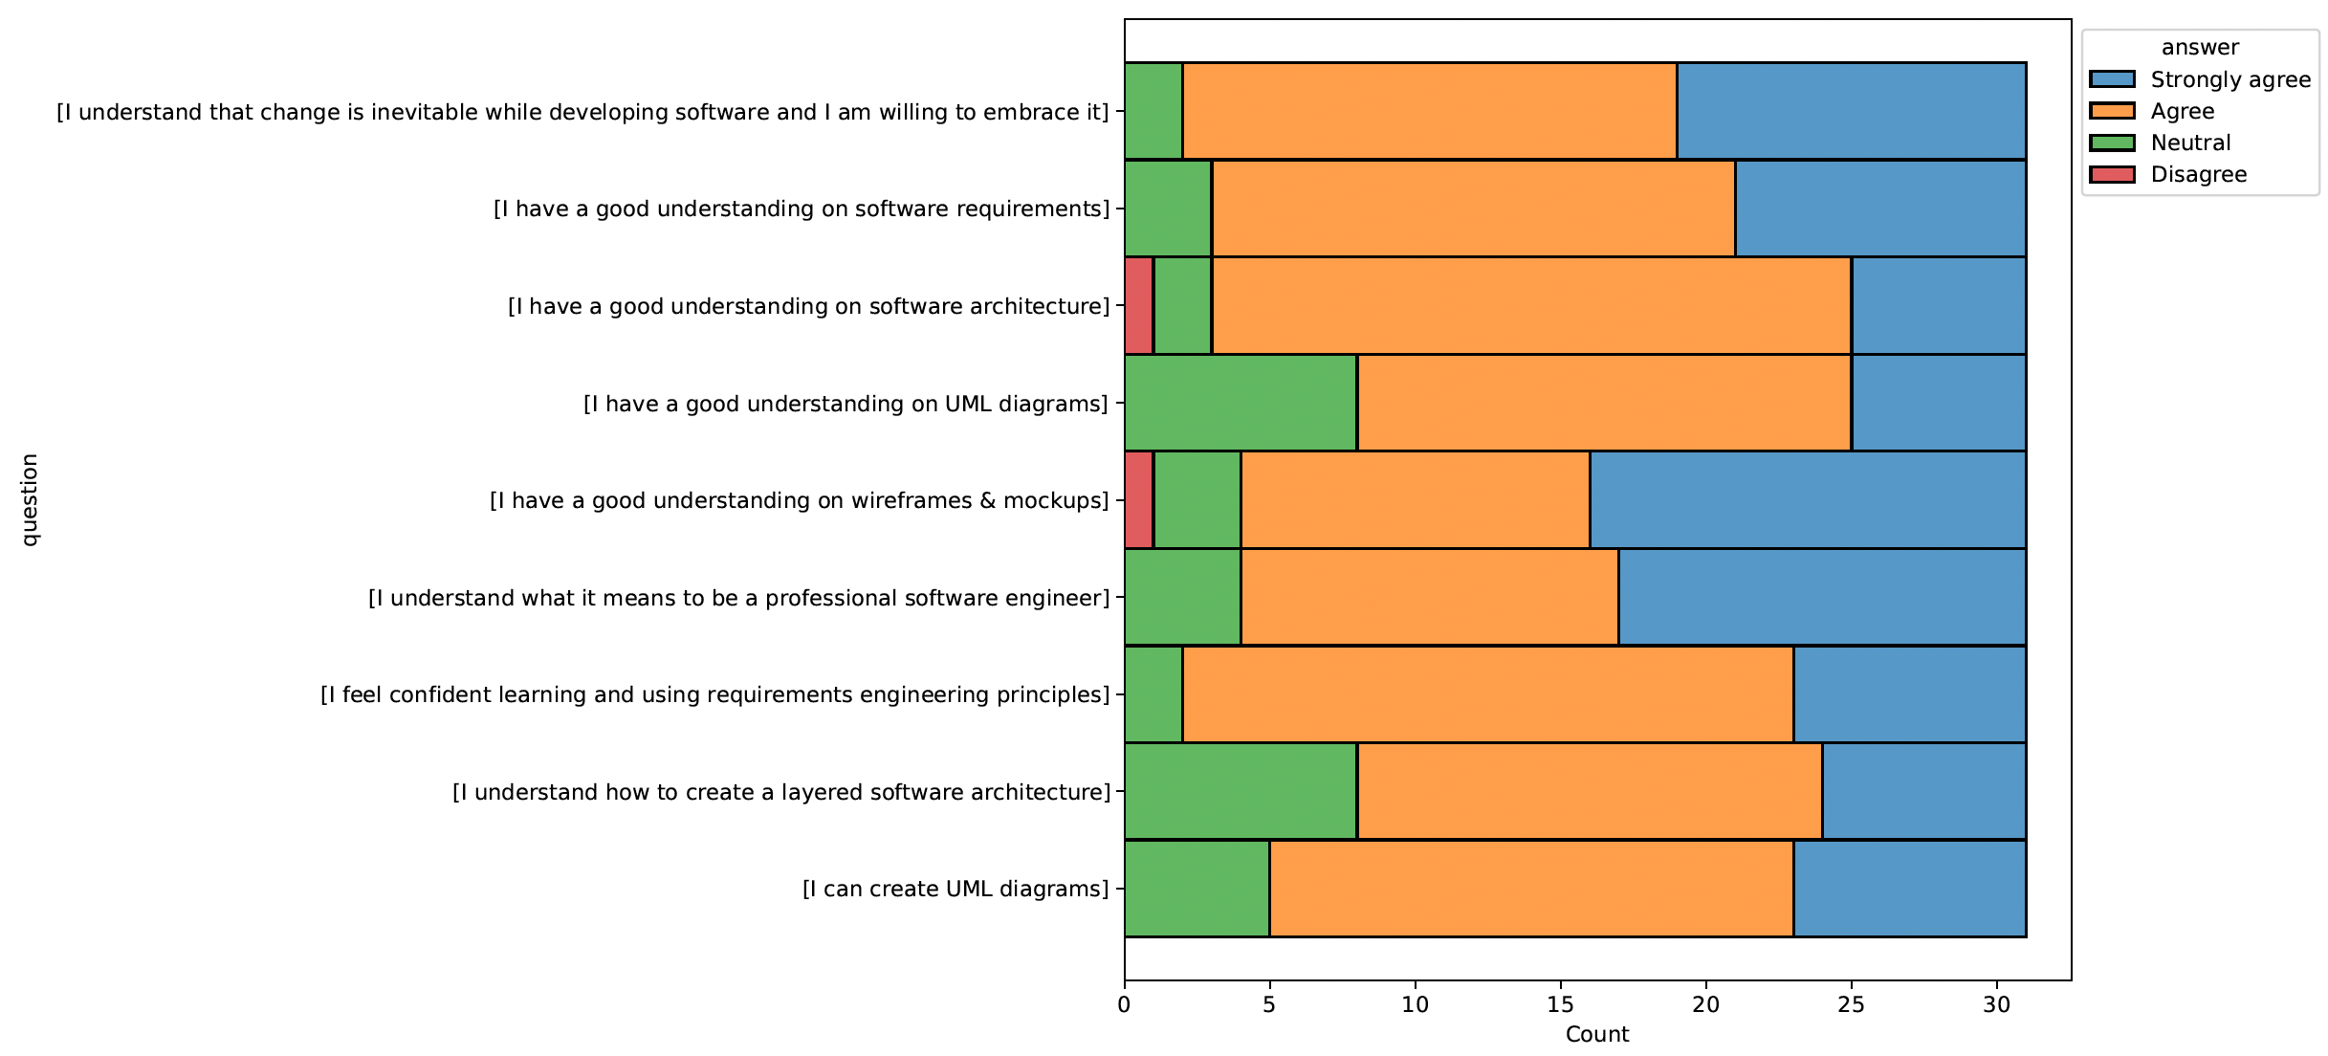
RQ4. Are the SW engineering principles and artifacts well understood?
some students noted a lack of knowledge in SW architecture/UML modeling

Slide 14
main conclusions
the relationship between learning software engineering concepts and Agile methodologies is reciprocal
improving students' communicative proficiency is fundamental to applying SCRUM
assimilating and applying the SCRUM methodology demands experience

Slide 15
?

